Slide 1
Stochastic SIR models
Nathan Green
Imperial College London

Slide 2
From deterministic to stochastic
Deterministic models don’t capture small sample variability
Capturing uncertainty important for many real-life scenarios
Main differences:
Continuous variables -> discrete numbers
Process rates -> process probabilities

Slide 3
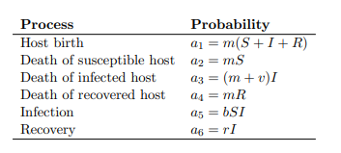
(Relative) Probabilities for SIR

Slide 4
Simulation
Computers like discrete variables
Could take a brute force approach
  For “small” time steps i.e. only at most one event can happen, determine state of system
  Avoid multiple events simultaneously
This is inefficient because in most steps nothing happens
Can we do better…?

Slide 5
Gillespie algorithm
Key idea: First determine when something happens
Suppose current time t
t + e at which something happens next is exponentially distributed random number
  Scaled by the sum of all process rates
In R we write
  tau <- rexp(1, rate=sum(a))
Gillespie, Daniel T. (1977). "Exact Stochastic Simulation of Coupled Chemical Reactions". The Journal of Physical Chemistry. 81 (25): 2340–2361

Slide 6
Then what happened next
Draw randomly from all possible processed according to their respective probabilities
Practically can sample an index
In R
  sample(length(a),1,prob=a)
We can then update the state of the system and iterate along.

